Slide 1

RV College of Engineering
Go, change the world
Introduction To C

Slide 2

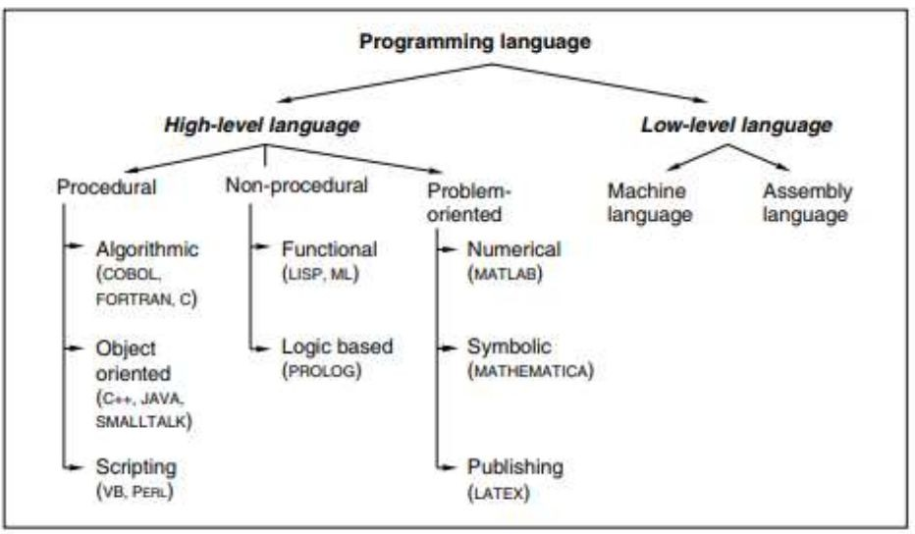
RV College of Engineering
Go, change the world
Programming Paradigms:

Slide 3
RV College of Engineering
Go, change the world
Programming Paradigms:
Low-level languages: Assembly language
each assembly language instruction accomplishes only a single operation and the coding for a problem is at the individual instruction level.
The high level programming languages may also be categorized into three groups— procedural, non-procedural, and problem oriented.
Procedural programming languages- Algorithmic, Object oriented and Scripting
Non Procedural Languages: Rule based languages or logic programming languages
Problem-oriented languages: MATLAB is a very popular language among scientists and engineers

Slide 4
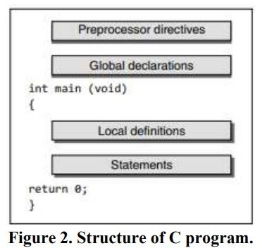
RV College of Engineering
Go, change the world
Basic Structure of C Program:

Slide 5
RV College of Engineering
Go, change the world
The process of compiling and running the C Program:
There are mainly three steps in developing a program in C:
Writing the C program
Compiling the program
Executing the program.

Slide 6
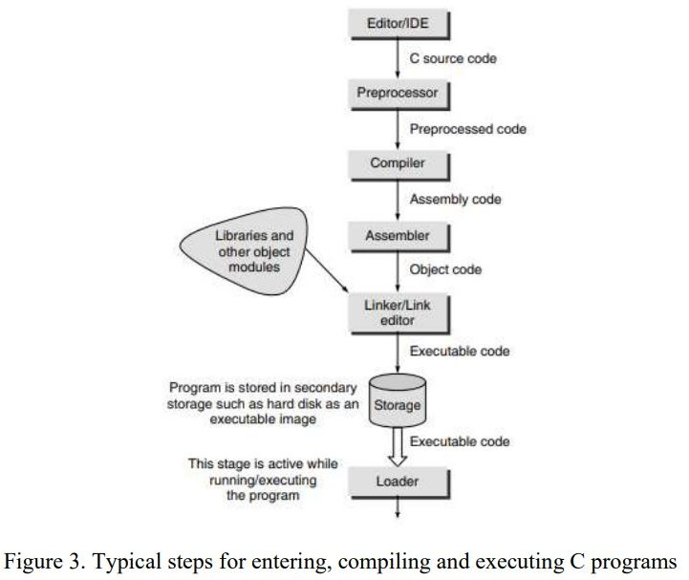
RV College of Engineering
The process of compiling and running the C Program:
Go, change the world

Slide 7
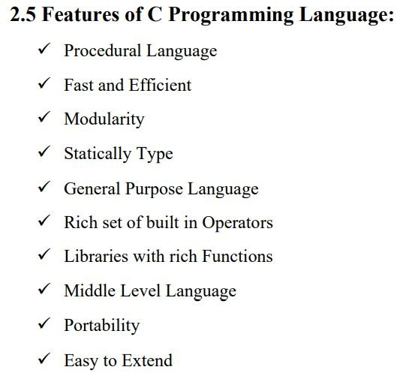
RV College of Engineering
Go, change the world

Slide 8
RV College of Engineering
Go, change the world
Character Set:
character:- It denotes any alphabet, digit or special symbol used to represent information. The characters in C are grouped into the following two categories:
Source character set
Alphabets
Digits
Special Characters
White Spaces

Slide 9
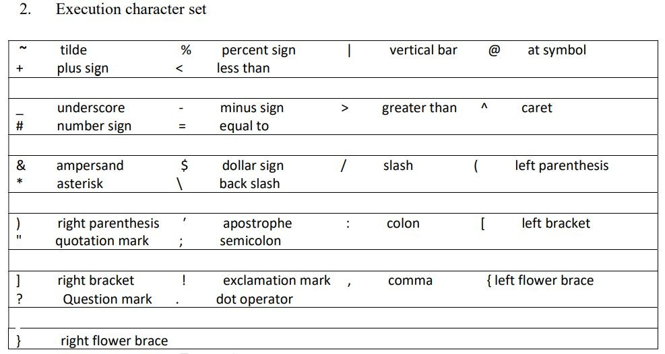
RV College of Engineering
Character Set:
Go, change the world

Slide 10
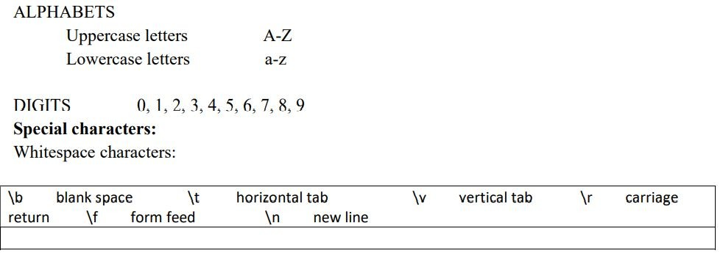
RV College of Engineering
Character Set:
Go, change the world

Slide 11
RV College of Engineering
Go, change the world
C Token:
Basic building block of a C-Program
Identifier It is a sequence of characters invented by the programmer to identify or name a specific object, and the nameis formed by a sequence of letters, digits, and underscores.
Keywords These are explicitly reserved words that have a strict meaning as individual tokens to the compiler. They cannot be redefined or used in other contexts. Use of variable names with the same name as any of the keywords will cause a compiler error.
3. Operators These are tokens used to indicate an action to be taken (usually arithmetic operations, logical operations, bit operations, and assignment operations). Operators can be simple operators (a single character token) or compound operators (two or more character tokens).

Slide 12
RV College of Engineering
Go, change the world
C Token:
Basic building block of a C-Program
Separators These are tokens used to separate other tokens. Two common kinds of separators are indicators of an end of an instruction and separators used for grouping.
Constant It is an entity that does not change.

Slide 13
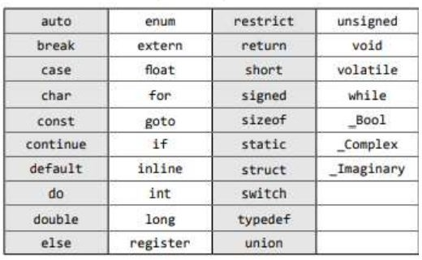
RV College of Engineering
Go, change the world
Keywords :

Slide 14
RV College of Engineering
Go, change the world
Identifiers :
Identifiers - In C, variables, arrays, functions, and labels are named.
The first character must be an alphabetic character (lower-case or capital letters) or an underscore ‘_’.
All characters must be alphabetic characters, digits, or underscores.
The first 31 characters of the identifier are significant. Identifiers that share the same first 31 characters may be indistinguishable from each other.
A keyword cannot be duplicated by an identifier. A keyword is word which has special meaning in C.
Some examples of proper identifiers are employee_number, box_4_weight, monthly_pay, interest_per_annum, job_number, and tool_4. Some examples of incorrect identifiers are 230_item, #pulse_rate, total~amount, /profit margin, and ~cost_per_ item.

Slide 15
RV College of Engineering
Go, change the world
Constants:
Fixed values that the program may not alter during its execution.
Integer constant: 1, 25, and 23456 are all decimal integer constants, a floating constant
Floating Point Constant: 0.002164 may be written in scientific notation as 2.164E-3 or 2.164e-3 The letter E (or e) stands for exponent.
Character constantcharacter constant ‘A’ is equivalent to writing down the hex value 41 or the octal value 101., or a string literal
String constant is a sequence of characters enclosed in double quotes. (the null character ‘\0’, to mark the end of the string)

Slide 16
RV College of Engineering
Go, change the world
Variables:
The name of a variable(called as identifier) can be composed of letters, digits, and the underscore character.
A variable is a name given to a storage area that programs can manipulate.
Example: a, b, sum, area_tri, pgm_a..

Slide 17
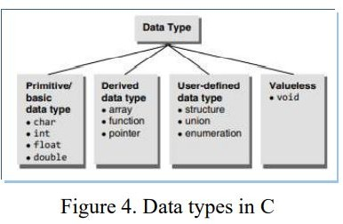
RV College of Engineering
Go, change the world
Data Types:

Slide 18
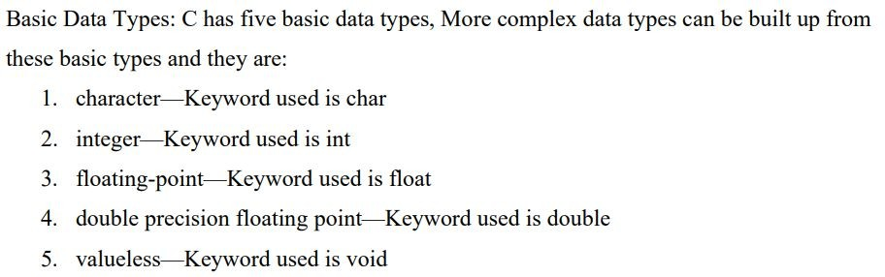
RV College of Engineering
Go, change the world
Data Types:

Slide 19
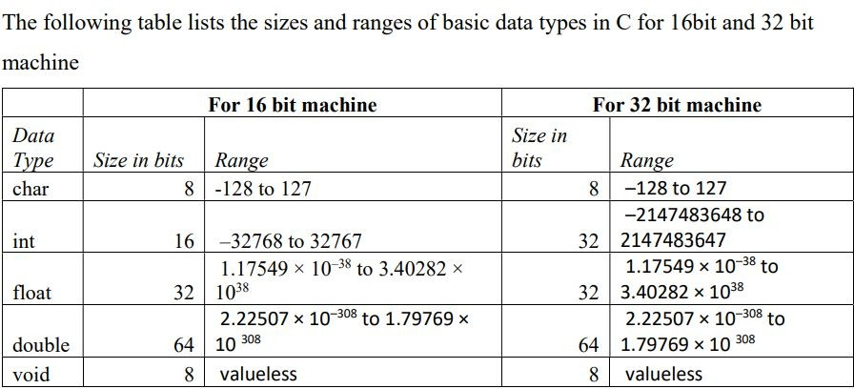
RV College of Engineering
Data Types:
Go, change the world

Slide 20
RV College of Engineering
Go, change the world
Pre-Processor Directives
□ Three uses of the preprocessor are:
directives
constants
macros.
Directives are commands that tell the preprocessor to skip part of a file, include another file, or define a constant or macro.
Directives always begin with a sharp sign - #

Slide 21
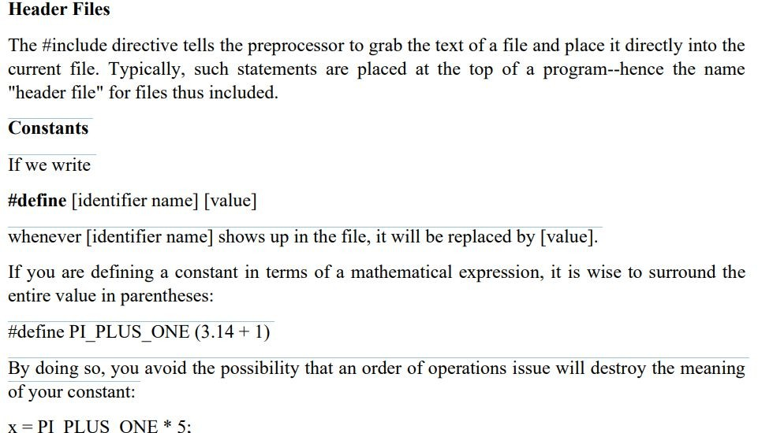
RV College of Engineering
Pre-Processor Directives
Go, change the world

Slide 22
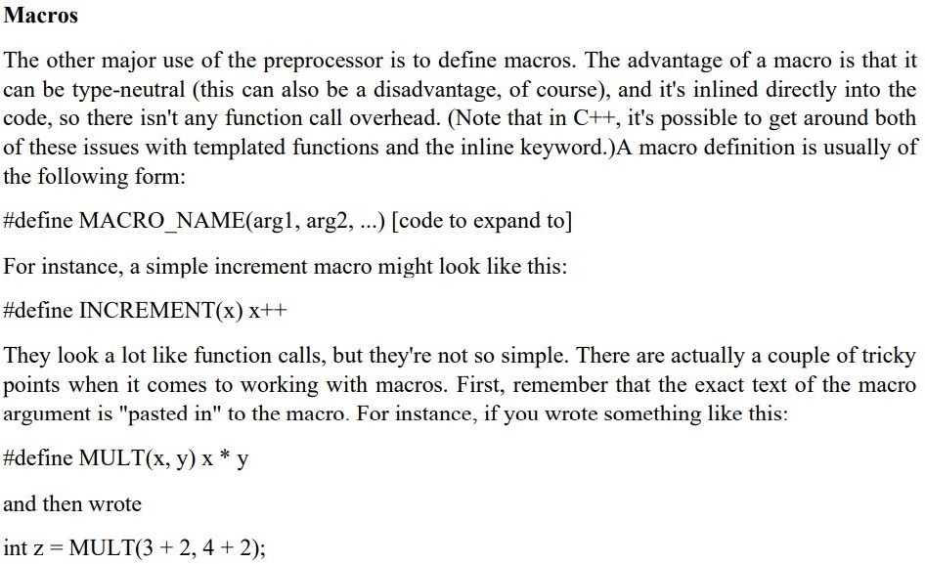
RV College of Engineering
Pre-Processor Directives
Go, change the world

Slide 23
RV College of Engineering
Pre-Processor Directves
Go, change the world

Slide 24
RV College of Engineering
Pre-Processor Directives
Go, change the world

Slide 25
END OF CHAPTER
23

